Slide 1

Hi I’m
Michael!
Student - Carleton CS
I like to play piano, swim and code!

Slide 2
Experience
Nokia Future Tech Intern | Competitive & Varsity Swimmer | Piano Teacher @Barrhaven Music Academy
Verification Testing Intern working on Optical Network Services | 4x NCSSAA Medalist 1x OFSAA Medalist | 2024 - Present, part-time teaching ~20 students a week

Slide 3
How did we get here
Try New Things
  Join class/activities that sound interesting
  Enhance many current hobbies

Slide 4
Nokia
Apps
How to get an internship
My experience + tips

Slide 5
Nokia Apps
Application Process Timeline
Apps Open -> Application -> Video Submission -> Interview -> Internship
Project Details
  Choosing the project
  What to avoid

Slide 6
Nokia Apps - Requirements
Who you are
You are a high school student who will be entering grade 12 in the fall of 2026 (You just finished grade 11).
You have a willingness to learn new things quickly and like to be challenged.
You are interested in exploring the world of high-tech.
You have a proven ability to work in a team environment (including extracurricular activities).
You may not have any experience in these fields, but you have a keen interest in computer science, computer engineering, software and hardware development.

Slide 7
Nokia Apps -Application
Applying ASAP
  Opens early into the year (Jan-Feb)
  Prepare, the earlier the better
  Have projects ready for the application
  Main project(s), other projects
  Earlier the better (Application/Interview)
  Earlier Interview is better

Slide 8

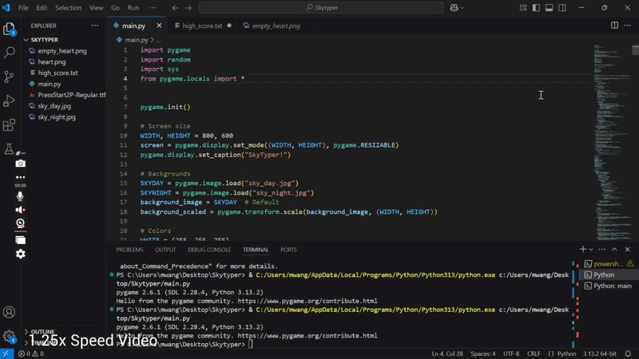
Nokia Apps - Video
Tips
  Single/Double Project
  Show off features
  Speak/explain clearly
  Show your interest

Slide 9
Nokia Apps - Interview
Behavioural Interview
  Explain Project Clearly (Framework, Features, Stack)
  Asks for other projects you’ve done (Overview)
  Remember to smile and highlight your personality

Slide 10
Nokia Apps - Internship
Congratulations!
  Take Initiative (Ask Questions, Learn for the experience)
  Connect with mentor (potential R.O.)
  Network (Employees, Different teams, Interns)
  Enjoy your time (explore the benefits of a office)

Slide 11
Choosing Nokia Project
Examples from 2025
  School Projects*
  Video Games
  Robotics*(School, Clubs, Personal Hardware Projects)
  Hackathon Projects*(Hardware/Software)
  Wellness Apps (Health, Therapy)
  Virtual Wardrobe (AI Chatbot, Visualisations)
  Network Security Systems (TLS fingerprinting)

Slide 12
Choosing Nokia Project
What to Avoid
  Large team projects as primary
  ex: Robotics
  Try to be specific on contribution
  School Assignments
  Less unique
  Could be same as other applicants
  Hackathon Projects*
  Super polished
  Unrelated Tech
  Ex: Video Editing, Building a Computer
  Focus on CS, CE, SE, Hardware

Slide 13
Nokia Project - Example
Skytyper - Video Game
  Single Project
  Video Game
  Content
  Features
  Framework
  Future Ideas

Slide 14
Balance
How to have fun in High School
Balance School and ECs

Slide 15
Time Management
Priority List
School
  Grades
  School
ECs
  Field Related: Hackathons, HOSA, Internships
  Unrelated: Sports, Music, Volunteering
Free Time
  Games, Reading, Sports

Slide 16
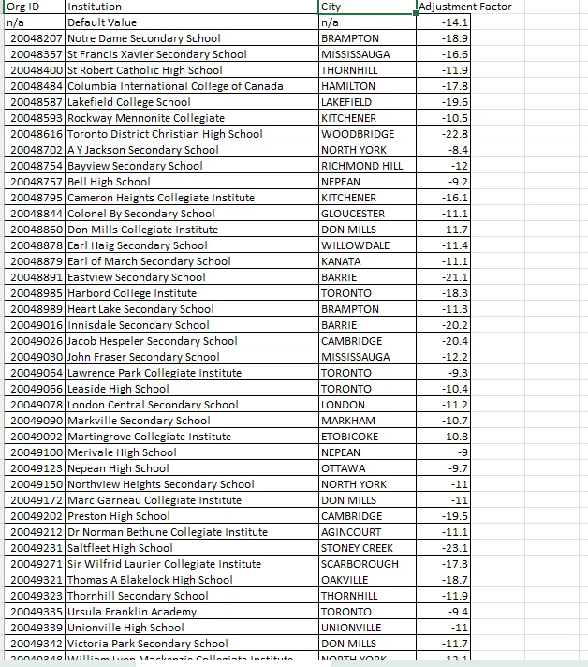
1 - School
Number 1 Priority
Where you go to School
  Adjustment Factor
  Opportunities (IB, Internships)
Grades
  Majority of Admission Decision

Slide 17
2 - Extra Curriculars
Hobbies to show your abilities
Examples
  Sports
  Clubs
  Music
  Volunteering
  Research
  Work
Show qualities
  Initiative
  Leadership
  Commitment
  Time Management

Slide 18
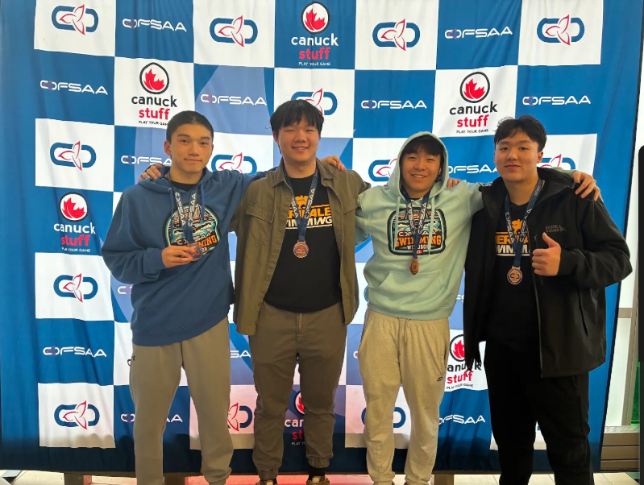
2 - Extra Curricular Activities
Examples
Swimming (7 - 10 hours a week)
  Shows Commitment
  Increase focus
Part-time Piano Teacher (6 hours a week)
  Time Management
  Problem solving
Hackathon Organization (2-4 hours a week)
  Volunteering, Leadership
  Tech Related

Slide 19
3 - Free Time
Relax but find something productive
Examples
  Sports
  Music
  Cooking
  Sleeping
  Reading
  Chess
  Playing Games
Benefits
  Health
  Increased focus
  Prevents Burnout

Slide 20
Questions?
Ask me anything
you would want to know

